Slide 1
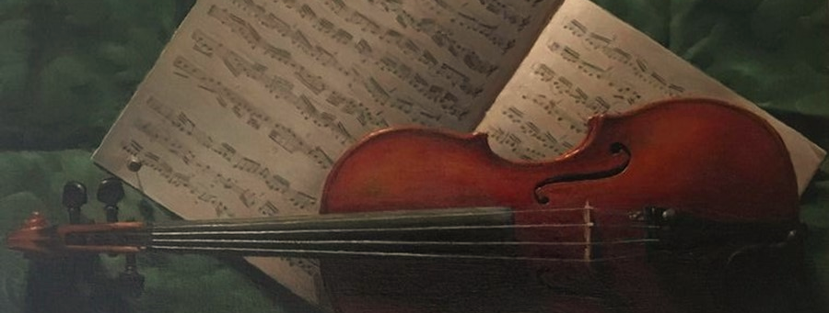
MusicNet Data
SC1015
FCCA
MINI PROJECT
Group 9
Lee Yi Ming, Bennett
Han Xin Yi, Heidi
Tan Sze Jin

Slide 2

Contents
Motivation
01
Data Preparation
11
Exploratory Analysis
13
Machine Learning
17
Conclusion
25

Slide 3



Motivations
Cultural Heritage
Music Education
Music Production
Understanding and documenting the types of instruments used in traditional music is crucial
Learning aid for students learning music by helping them in ear training and music theory studies
In the process of mixing and mastering by automatically identifying and tagging tracks with the correct instrument labels
Notes:
1. Enhancement of Music Education
A machine learning model that classifies musical instruments can be an invaluable tool in educational settings. It can help students more quickly identify and distinguish between sounds of different instruments, aiding in ear training and music theory studies. For beginners, such interactive tools can make learning more engaging and intuitive.
2. Assistance in Music Production and Audio Engineering
In the realm of music production and audio engineering, such a model can streamline the process of mixing and mastering by automatically identifying and tagging tracks with the correct instrument labels. This can save time and reduce the workload on human engineers, allowing them to focus on more creative aspects of production.
6. Preservation of Cultural Heritage
In cultural studies and preservation, understanding and documenting the types of instruments used in traditional music is crucial. A model that can classify instruments can help in the digital preservation efforts of rare and ethnic music recordings, ensuring that cultural heritage is maintained for future generations.

Slide 4
Data Preparation
Tasks
MusicNet is a collection of 330 classical music recordings
Only solo music recordings are used to accurately predict the most dominant instrument present in an audio recording
MusicNet Dataset
Extracting Solo Recordings
Sorting Extracted Files
Split into 1-Second Segments
Delete Excess Training Data
Data Cleaning
Notes:
MusicNet is a collection of 330 classical music recordings.
To effectively learn the distinctive acoustic characteristics inherent to each instrument, we decided to only use music recordings that have solo ensembles.

Slide 5
Data Preparation
Tasks
Solo recordings are extracted based on the ensemble label of the music recording
MusicNet Dataset
Extracting Solo Recordings
Sorting Extracted Files
Split into 1-Second Segments
Delete Excess Training Data
Data Cleaning
Notes:
To prepare our curated dataset, we will first extract the solo recordings from MusicNet

Slide 6
Data Preparation
Tasks
Solo recordings are extracted based on the ensemble label of the music recording
These recordings are then sorted to its respective train/test instrument folders
MusicNet Dataset
Extracting Solo Recordings
Sorting Extracted Files
Split into 1-Second Segments
Delete Excess Training Data
Data Cleaning
Notes:
Once the solo recordings are isolated, our next task is to categorise these files into its respective train and test folders.

Slide 7
Data Preparation
Tasks
To allow for real-time predictions and analysis on the features, the recordings are split into
1-second segments
MusicNet Dataset
Extracting Solo Recordings
Sorting Extracted Files
Split into 1-Second Segments
Delete Excess Training Data
Data Cleaning
Notes:
The complexity of musical composition demands that we simplify our data into manageable segments for analysis. In addition to this, if we want to use the model for live predictions, we must dissect the continuous audio into discrete one-second intervals.

Slide 8
Data Preparation
Tasks
To allow for real-time predictions and analysis on the features, the recordings are split into
1-second segments
Some classes have more training files than others. To prevent overfitting, excess files are deleted at random
MusicNet Dataset
Extracting Solo Recordings
Sorting Extracted Files
Split into 1-Second Segments
Delete Excess Training Data
Data Cleaning
Notes:
After segmenting the audio recordings, some classes have more segments than others. An overabundance of data for certain instruments can skew the learning process. To prevent such overfitting, the dataset is strategically pruned and the files are deleted at random.

Slide 9
Data Preparation
Tasks
After random sampling of the audio files, we found that there was little to no noise in the audio files
MusicNet Dataset
Extracting Solo Recordings
Sorting Extracted Files
Split into 1-Second Segments
Delete Excess Training Data
Data Cleaning
Notes:
The audio files from the MusicNet Dataset are studio recorded. Random sampling of the audio files further verifies it as we find that there were little to no noise in the audio files. Hence, no augmentation techniques are applied to the audio.

Slide 10
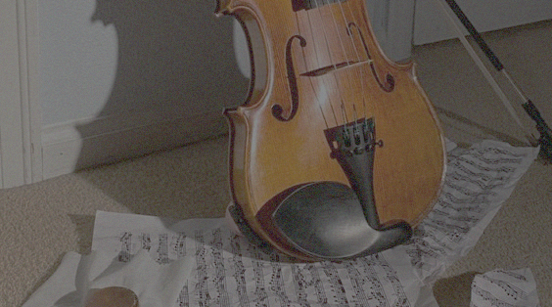
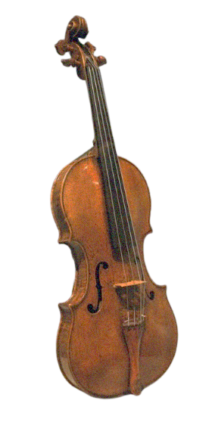
Exploratory Data Analysis

Slide 11
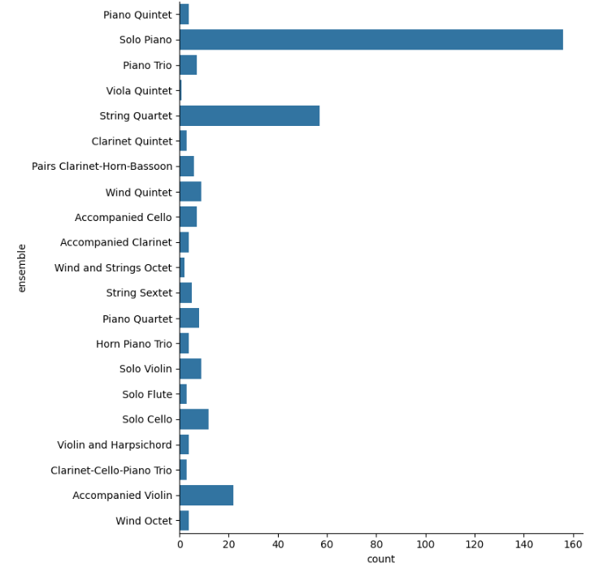
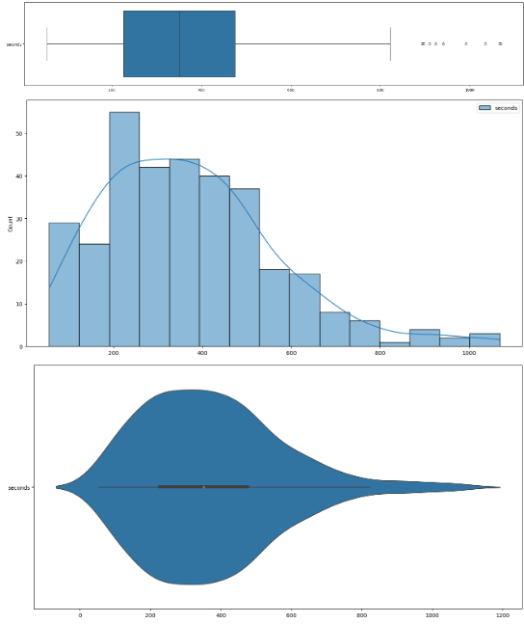
Exploratory Analysis on metadata:
Boxplot, Histogram & Violinplot of Duration
Catplot of Ensemble
Notes:
First we did EDA on the metadata, because our dataset is very large,
so doing analysis on the metadata
can provide significant insights into the types and structure of the data,
and help to inform further data preparation and analysis.

Slide 12
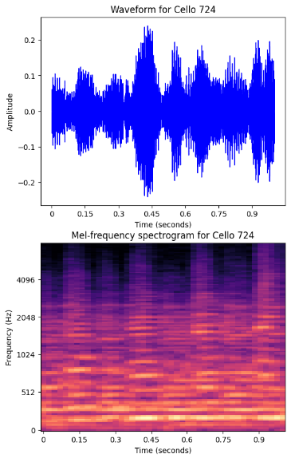
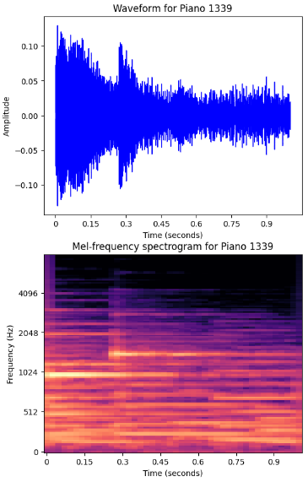
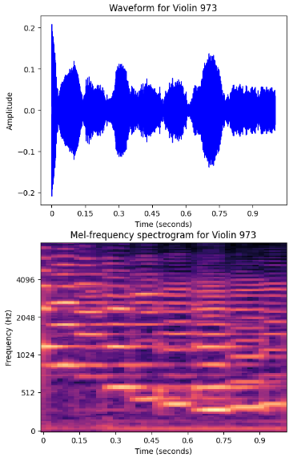
Exploratory Analysis on data:
Waveform and Spectrogram
Cello
Piano
Violin
Notes:
We plotted the waveforms and spectrograms of random 1 second audio files
Waveforms visualise the amplitude of audio signals over time, which can give insights into
loudness and energy.
Spectrograms represent the frequency content of the audio over time, which is useful for
identifying different sounds.

Slide 13
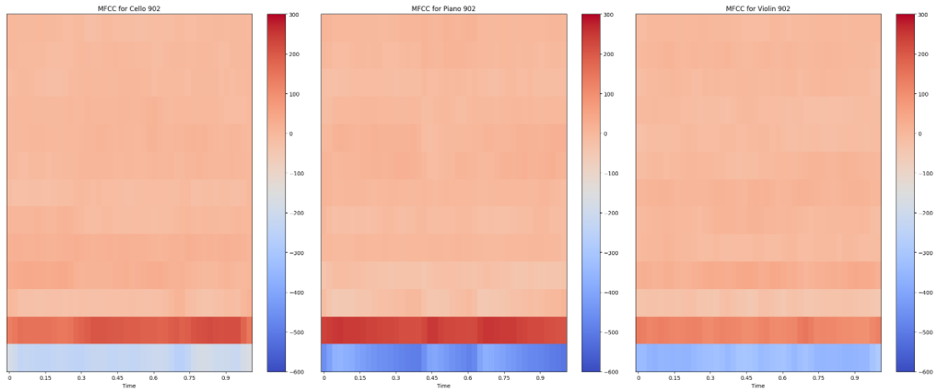
Mel-Frequency Cepstral Coefficients (MFCC)
Exploratory Analysis on data:
Cello
Piano
Violin
Notes:
Next, we also plotted the heatmaps of the . . .
MFCCs visualise the timbral texture of the audio.
Timbre is the quality of a musical note or sound that distinguishes
different types of sound production, including musical instruments,
and is often referred to as the "color" of the sound.
In the heatmaps, the color intensity represents the magnitude of the MFCC values at each
point in time.
Low-order MFCCs (toward the top of each plot) : Captures the overall envelope shape
of the spectral energy distribution
High-order MFCCs (toward the bottom of each plot) : Captures finer details of the timbre

Slide 14
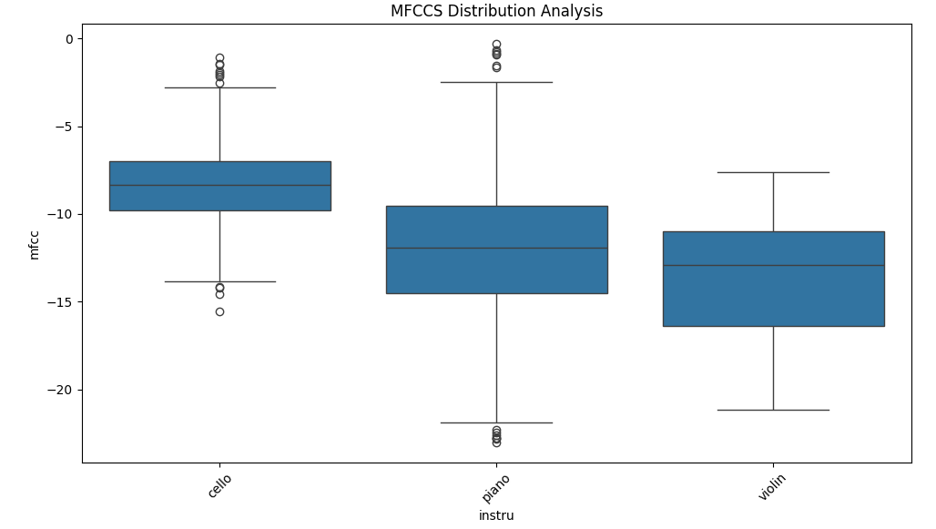
Exploratory Analysis on data:
Mean MFCC Values

Slide 15
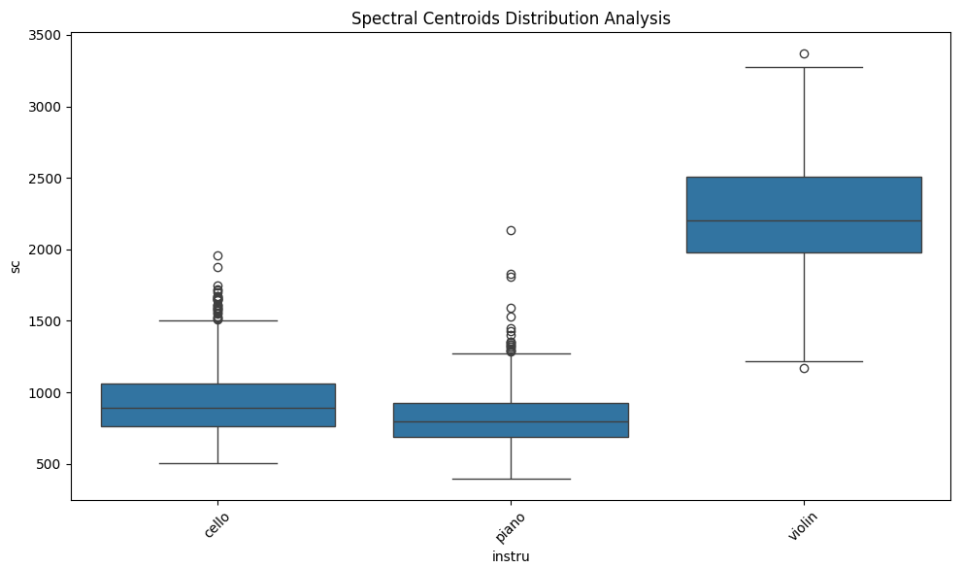
Exploratory Analysis on data:
Mean Spectral Centroid Values
Notes:
Spectral centroid represents the “center of mass” of the spectrum
and shows the average frequency of the sound, which can help us understand the
perceived pitch and timbre.

Slide 16
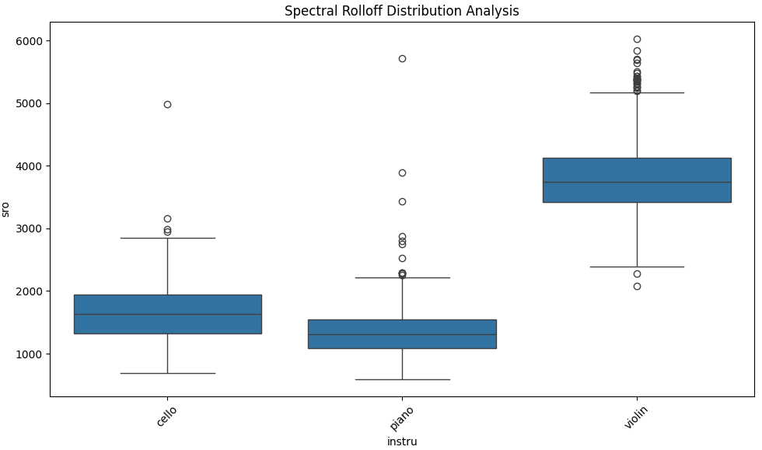
Exploratory Analysis on data:
Mean Spectral Rolloff Values
Notes:
Spectral rolloff is defined as the frequency below which a certain percentage
(set as 85%) of the total energy of the spectrum is contained, and the spectral rolloff point
can be used to distinguish between harmonic (musical tones) and noise-like components of
the audio signal.

Slide 17
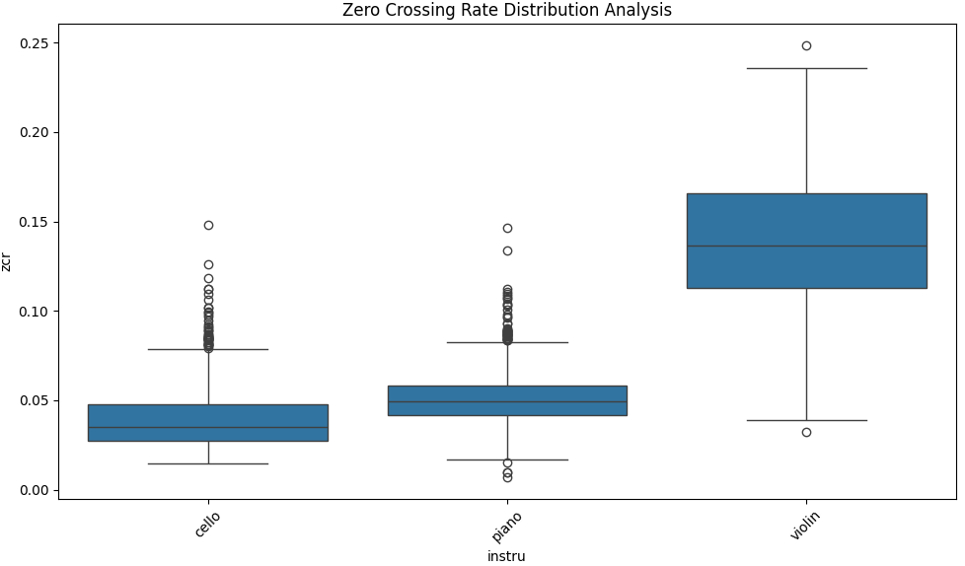
Exploratory Analysis on data:
Mean Zero Crossing Rate Values
Notes:
Zero crossing rate measures how frequently the speech signal changes its polarity or
crosses the zero amplitude line, representing the rate of changes in the audio waveform.

Slide 18
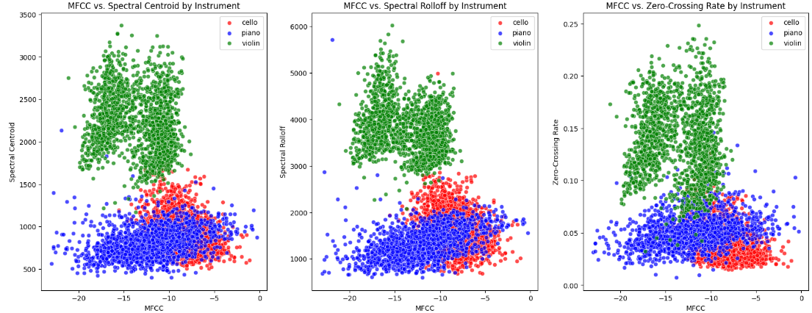
Exploratory Analysis on data:
MFCC, Spectral Centroid, Spectral Rolloff, ZCR
Notes:
We also plotted the scatterplots of these 4 features, colour coded according to instrument
From the Boxplots and Scatterplots, we can see that these 4 features from each instrument
can be grouped together, with the those for Violin the most differentiable from the rest.
This presents valuable insights as to the features or pairs of features that are important
for categorising the audio samples.

Slide 19
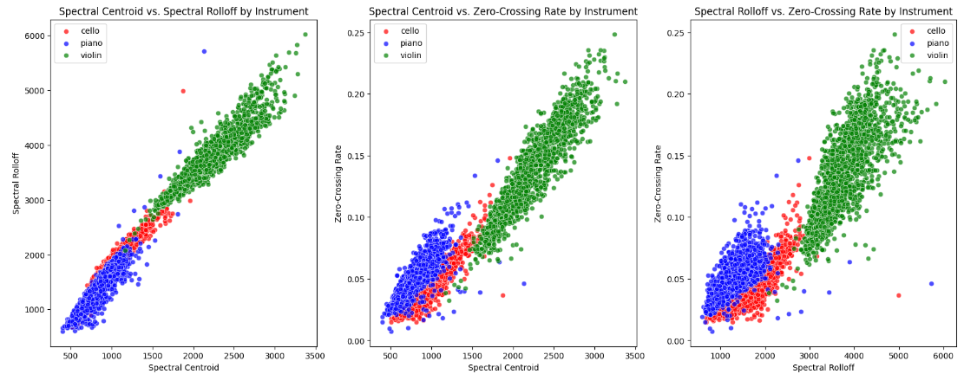
Exploratory Analysis on data:
MFCC, Spectral Centroid, Spectral Rolloff, ZCR

Slide 20
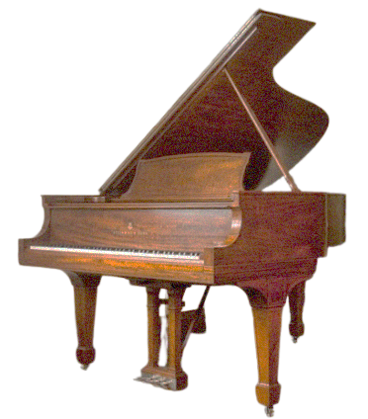
Machine Learning Techniques

Slide 21
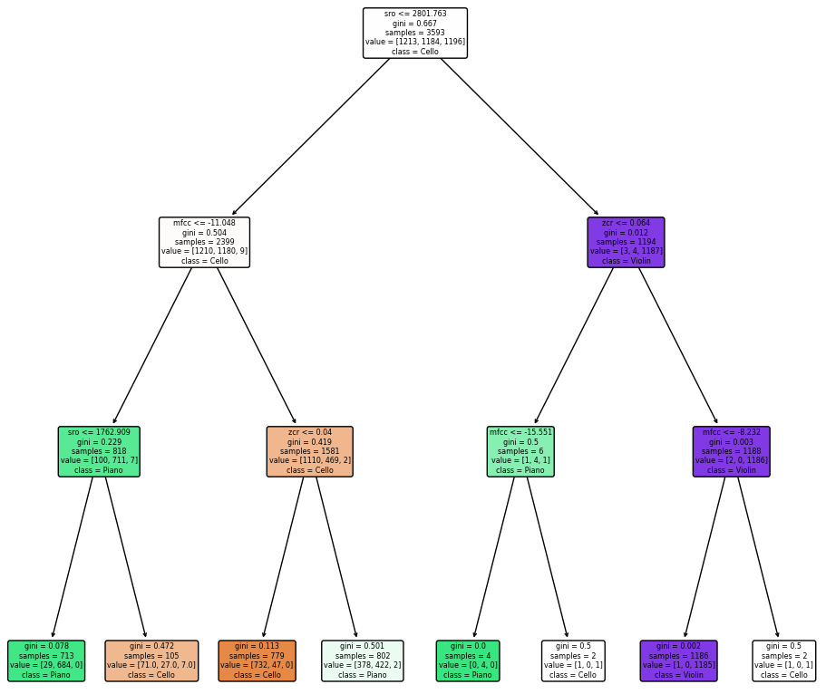
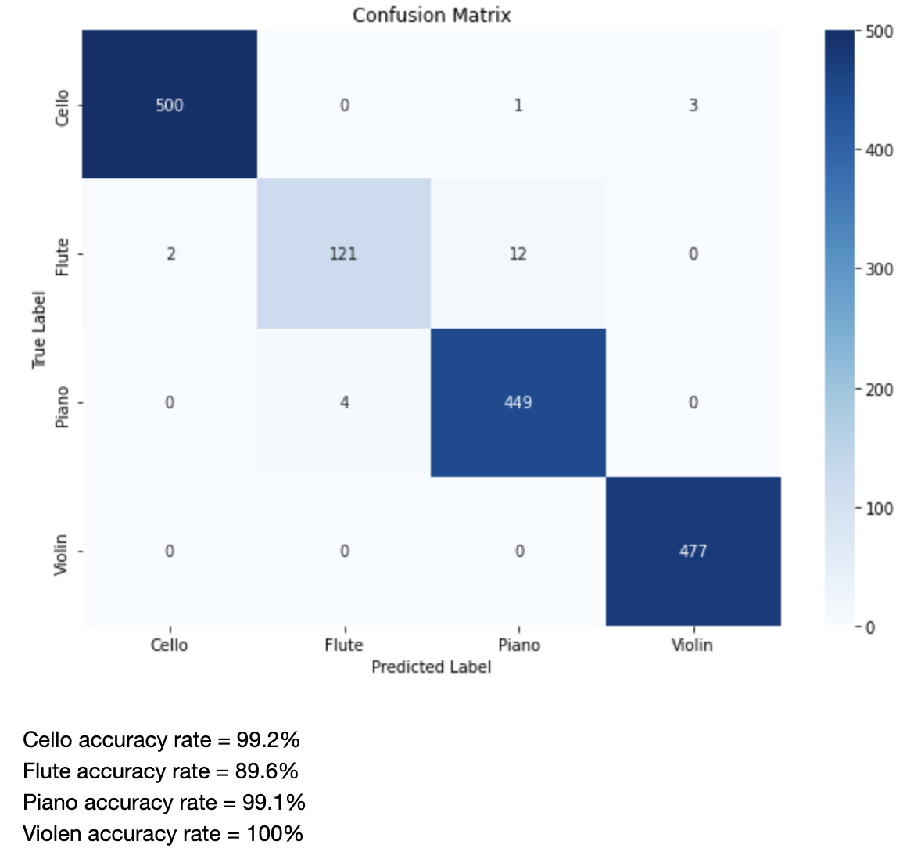
Random Forest
Classification Tree
Random Forest operate by constructing multiple decision trees during training and outputs the consensus of these trees for prediction tasks
Each tree is trained on a different sample drawn with replacement from the training set to ensure diversity among the trees
During testing, each tree votes on a class and the average of the outputs across all trees is taken
Testing on MusicNet Data gave a high accuracy rate of 98.6%
Random Forest is an effective method for this instrument classification task
Extracted the MFCC, spectral centroid, spectral rolloff and zero-crossing rate for decision tree
For tree of max depth 2, classification accuracy = 84.0%
For tree of max depth 3, classification accuracy = 85.8%
For tree of max depth 4, classification accuracy = 92.5%
Notes:
Because this is a classic classification problem, we used a classification tree, and used
The 4 features from before to train it
For a tree of max depth 4, the accuracy we got was 92.5%

Slide 22
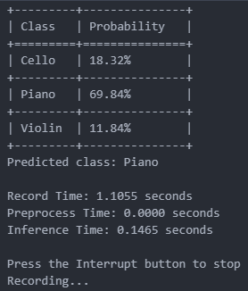
Random Forest
Wav2Vec2
Live Prediction
Classification Tree
Random Forest operate by constructing multiple decision trees during training and outputs the consensus of these trees for prediction tasks
Each tree is trained on a different sample drawn with replacement from the training set to ensure diversity among the trees
During testing, each tree votes on a class and the average of the outputs across all trees is taken
Testing on MusicNet Data gave a high accuracy rate of 98.6%
Random Forest is an effective method for this instrument classification task
Uses CNN which serves as a feature encoder
Transformer’s attention mechanism is used to generate contextualized representation of the features
Pre-trained to understand human speech but is adapted to classify musical sound
Validation Accuracy: 99.85%
Extracted the MFCC, spectral centroid, spectral rolloff and zero-crossing rate for decision tree
For tree of max depth 2, classification accuracy = 84.0%
For tree of max depth 3, classification accuracy = 85.8%
For tree of max depth 4, classification accuracy = 92.5%
Notes:
Wav2Vec2 stands out in the world of audio processing. Originally designed for speech recognition tasks, this model uses a convolutional neural network (CNN) to extract features from raw audio waveforms.
What makes Wav2Vec2 exceptional is its use of the Transformer's attention mechanism. This allows the model to focus on specific parts of an audio signal and understand the context better—vital for distinguishing between the subtle nuances of different musical instruments.
Though pre-trained on human speech, we've adapted Wav2Vec2 to the realm of music. By fine-tuning it with the MusicNet Dataset of instrument sounds, the model has learned to identify the unique acoustic signatures of various instruments.
Our results have been outstanding, with the model achieving a validation accuracy of 99.85%. This level of precision is a testament to the model's ability to capture the complex auditory patterns associated with different instruments.

Slide 23
Random Forest
Wav2Vec2
Live Prediction
Random Forest operate by constructing multiple decision trees during training and outputs the consensus of these trees for prediction tasks
Each tree is trained on a different sample drawn with replacement from the training set to ensure diversity among the trees
During testing, each tree votes on a class and the average of the outputs across all trees is taken
Testing on MusicNet Data gave a high accuracy rate of 98.6%
Random Forest is an effective method for this instrument classification task
Uses CNN which serves as a feature encoder
Transformer’s attention mechanism is used to generate contextualized representation of the features
Pre-trained to understand human speech but is adapted to classify musical sound
Validation Accuracy: 99.85%
Notes:
Wav2Vec2 is originally designed for speech recognition tasks, this model uses a convolutional neural network (CNN) to extract features from raw audio waveforms.
What makes Wav2Vec2 exceptional is its use of the Transformer's attention mechanism. This allows the model to focus on specific parts of an audio signal and understand the context better—vital for distinguishing between the subtle nuances of different musical instruments.
Though pre-trained on human speech, we've adapted Wav2Vec2 to the realm of music. By fine-tuning it with the MusicNet Dataset of instrument sounds, the model has learned to identify the unique acoustic signatures of various instruments.
Our results have been outstanding, with the model achieving a validation accuracy of 99.85%. This level of precision is a testament to the model's ability to capture the complex auditory patterns associated with different instruments.

Slide 24

Conclusion
Model | Validation Accuracy (%)
Classification Tree | 94.07
Random Forest | 98.60
Wav2Vec2 | 99.85
Wav2Vec2 produced the highest accuracy model
Classification Tree and Random Forest require simple machine learning methods
Wav2Vec2 takes a longer time to classify the audio recording
Notes:
In conclusion, the Wav2Vec2 model outperforms traditional machine learning models such as the Classification Tree and Random Forest in terms of validation accuracy on audio data. With an impressive 99.85% accuracy, Wav2Vec2 demonstrates the strength of deep learning techniques in extracting complex patterns and features from raw audio, which is especially critical in tasks requiring fine-grained audio understanding.
While the Wav2Vec2 model exhibits outstanding validation accuracy, it's important to recognize that such sophisticated models typically require more computational resources. Specifically, they often demand greater processing power and longer inference times compared to simpler models like Classification Trees or Random Forests. This can be a critical disadvantage in real-time or resource-constrained environments where quick decision-making is essential.
Thus, when considering the deployment of such models for live prediction, especially on mobile devices, it's crucial to balance the need for high accuracy against the available computational resources and the requirements for timely responses.

